Slide 1
Microsoft Teams
Tips & Tricks
Cherlyn Wilson
Division of Information Technology
March 1st, 2023
12:00 p.m. – 12:30 p.m.

Slide 2
Today’s Objectives:
At the end of our time today, you will be able to:
Download the Teams app
Understand the icons on the left-hand side
Add a new Team or Channel
Schedule a Meeting
Record a Meeting & Start Transcription
Locate the Attendance List
Create Announcements in a Channel
Select a Background for Video

Slide 3
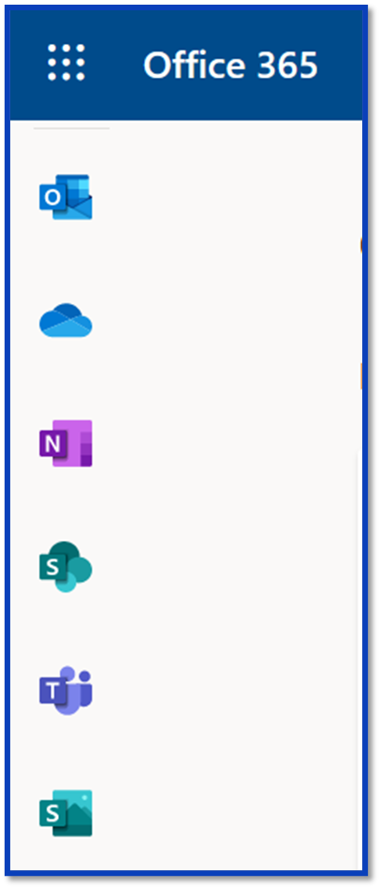
Downloading Teams
Go to Office365.Creighton.edu
Select the Teams icon on the left.
Web or download the Teams desktop app.
Mobile Apps are also available.

Slide 4
Teams Icons
Activity
Chat
Teams
Assignments
Calendar
Calls
Files
More Added Apps
Apps
Help

Slide 5
Teams & Channels
What’s the difference?
Teams – Department or Group
Posts
Files
Notebook
Others: Sharepoint, Onenote, etc.
Channels – Subgroup (public or private)

Slide 6
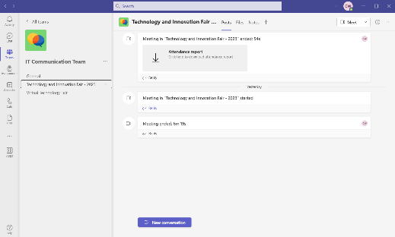
Teams & Channels
Team
Channel

Slide 7
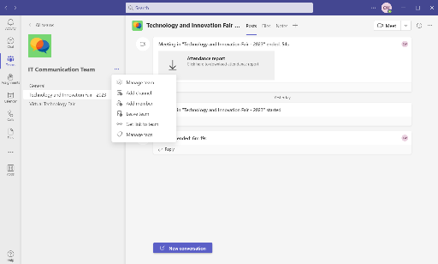
Teams & Channels
Team
Channel

Slide 8
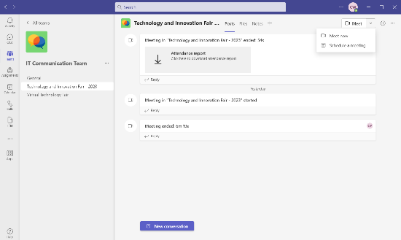
Schedule a Meeting

Slide 9
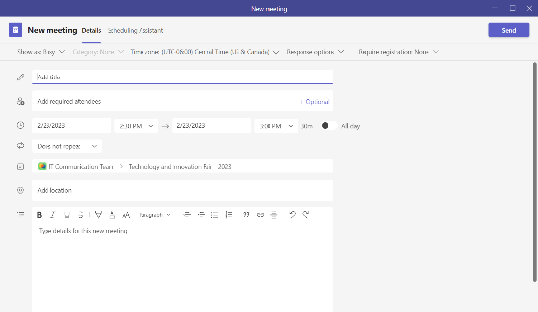
Schedule a Meeting

Slide 10
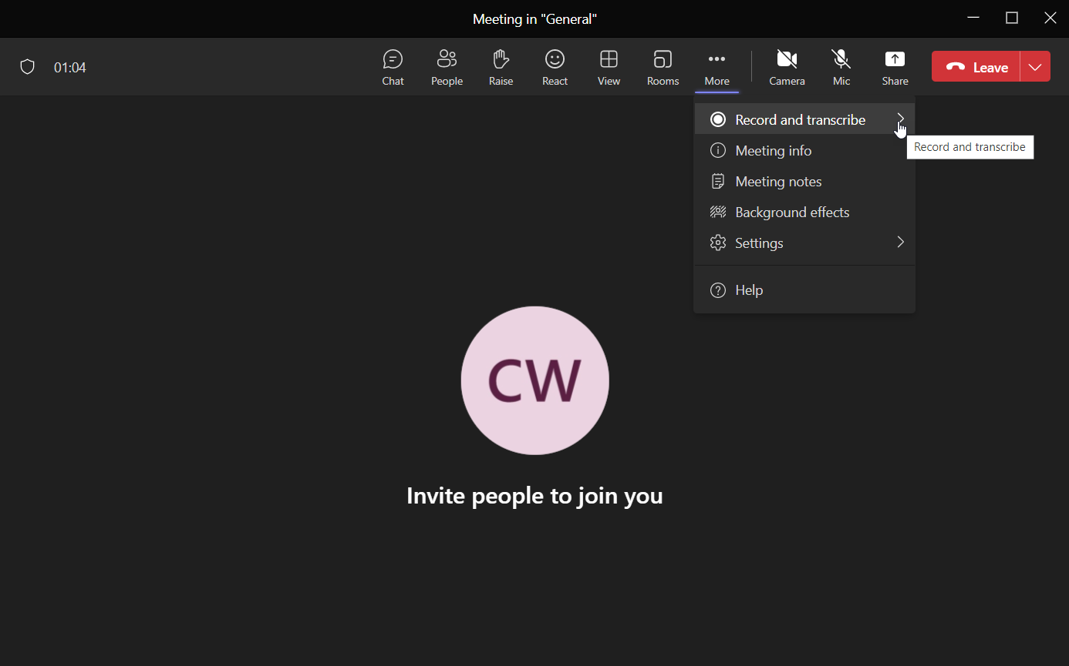
Record & Transcribe

Slide 11
Downloading Attendance List
The Attendance Report will show up after your meeting is done.
Click in the box.

Slide 12
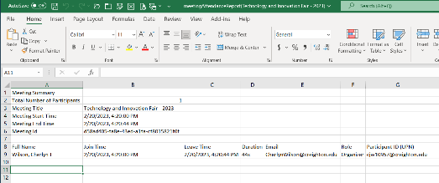
Downloading Attendance List
Go to File Explorer.
Select Downloads.
Find & select the spreadsheet.

Slide 13
Creating An Announcement
Start a New Conversation.
Click on the Format icon.
Select the drop down for New Conversation.
Select Announcement.
Type a Headline, subhead, & your announcement.
You can also customize the background of your headline.

Slide 14
Creating An Announcement

Slide 15
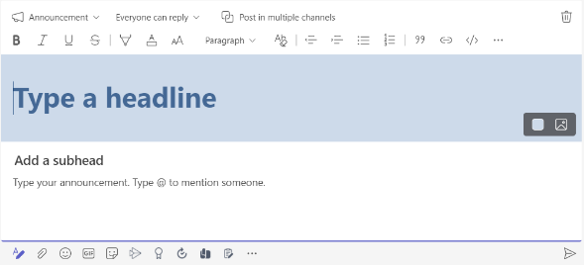
Creating An Announcement

Slide 16
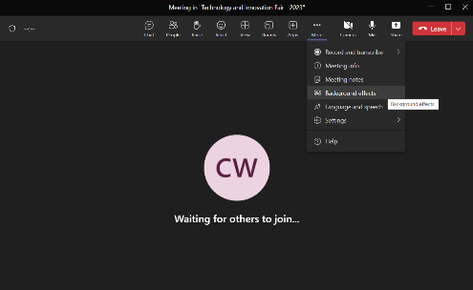
Selecting a Background for Video

Slide 17
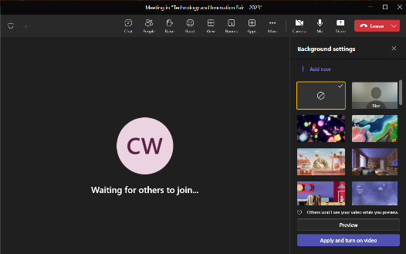
Selecting a Background for Video

Slide 18
Teams Help
https://support.microsoft.com/en-us/teams-meetings?OCID=Teams_MeetingsUbarMoreActions_Help

Slide 19
Questions?
Service Desk: 402-280-1111
servicedesk@creighton.edu
Cherlyn Wilson
Division of Information Technology
cherlynwilson@creighton.edu
402-280-3520

